Slide 1
LEGATO Leadership College Brussels 14 June 2024 “There’s a Place For Us” Growing your choir’s audience & membership so you can thrive

Slide 2
LEGATO Leadership College Brussels 14 June 2024
What will we cover today?
What is Audience Development?
Ten steps to create and deliver your own Audience Development Plan: - Strategy - Activity - Learning
Group Discussion & Advice Surgery

Slide 3
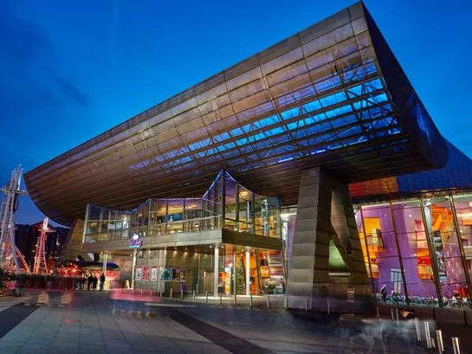
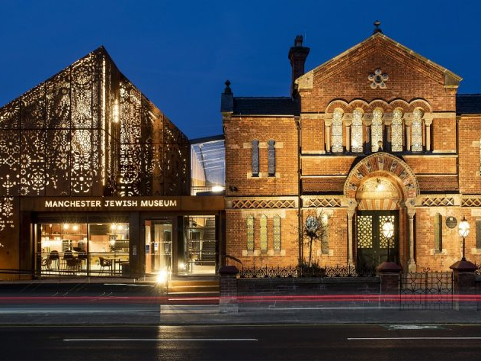
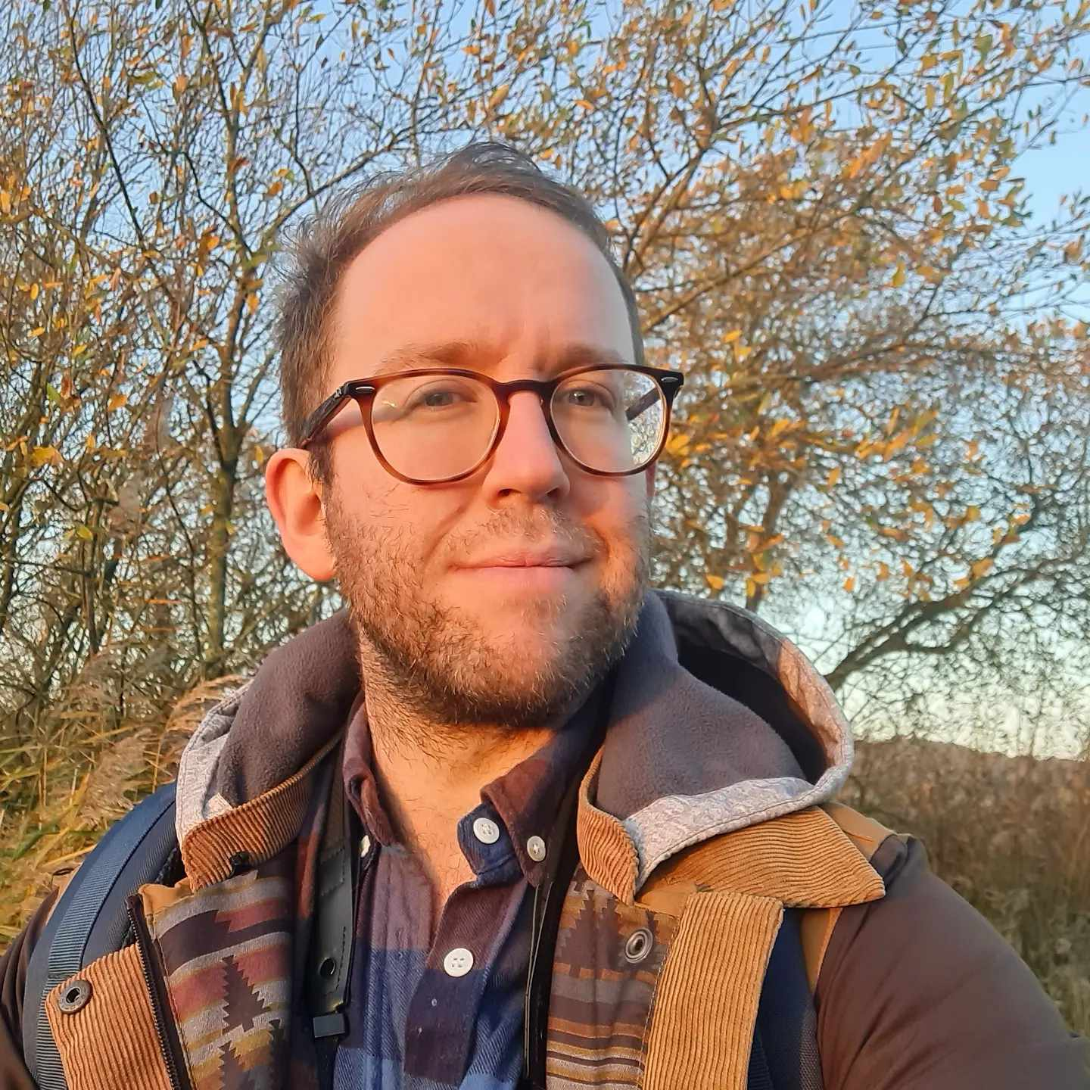
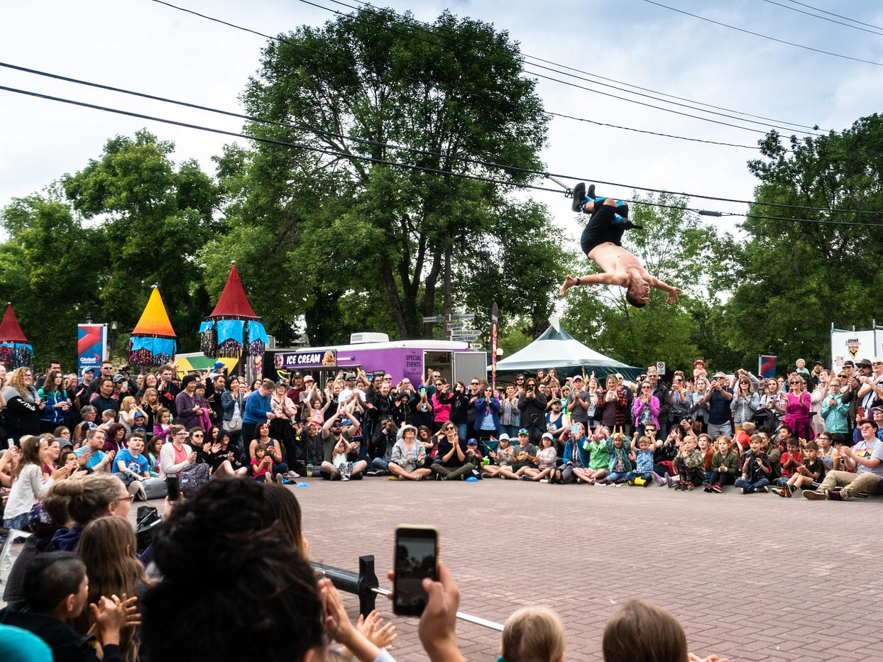
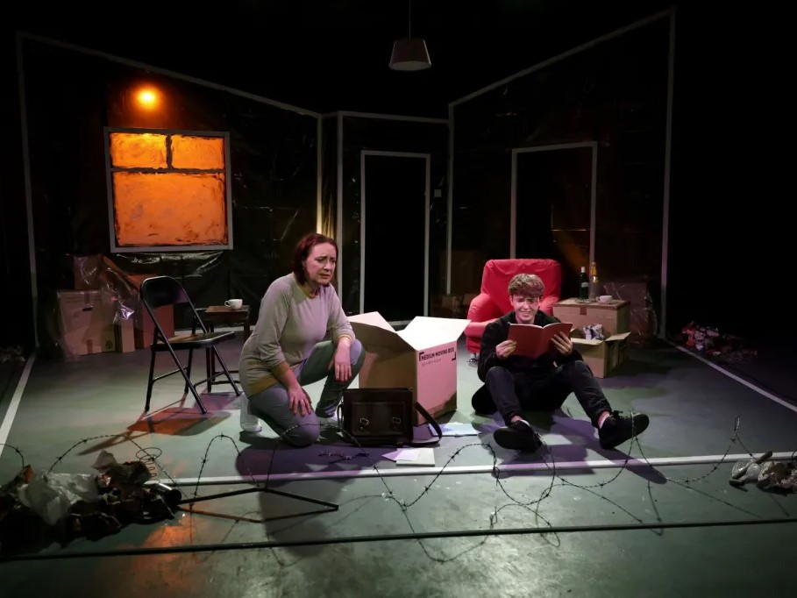
LEGATO Leadership College Brussels 14 June 2024
About Me
Dan Jarvis (He/Him)
#ActuallyAutistic

Slide 4
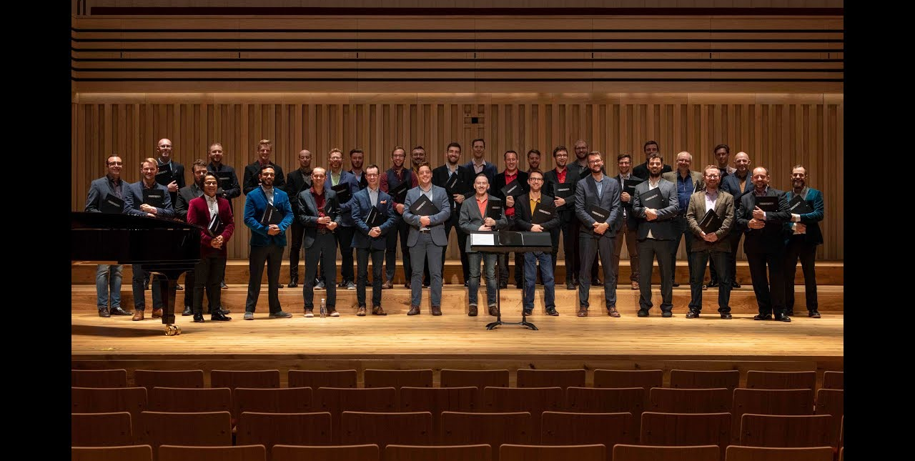
LEGATO Leadership College Brussels 14 June 2024
The Sunday Boys

Slide 5
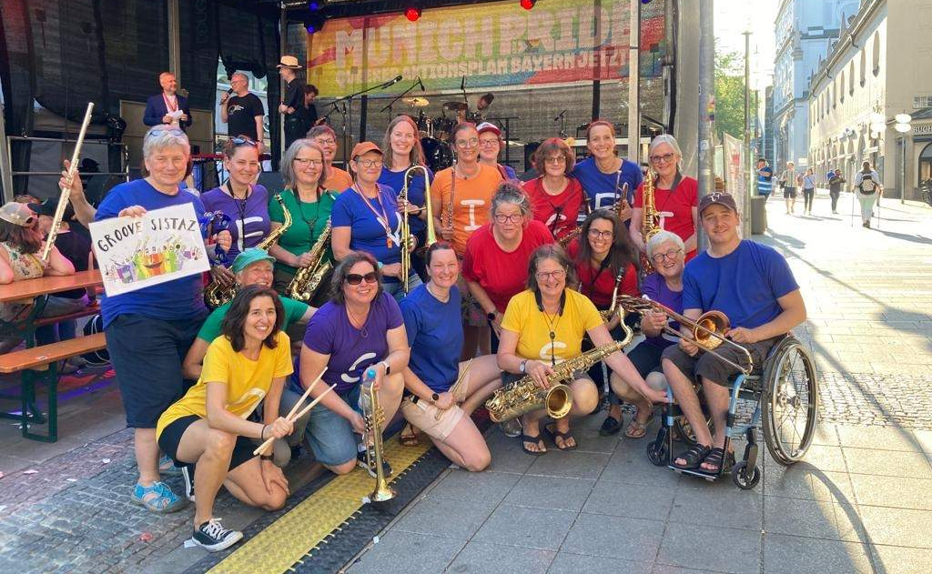
LEGATO Leadership College Brussels 14 June 2024
Section 1: What is Audience Development?
Groove Sistaz

Slide 6
LEGATO Leadership College Brussels 14 June 2024
Who are audiences?
Members of the choir
Supporters
Family & Friends
Paying audiences
Sponsors and funders
Online audiences
Groups your choir work with
People who are thinking about joining or watching your choir, but might not be ready yet
People who have never thought about joining or watching your choir, but might really benefit

Slide 7
LEGATO Leadership College Brussels 14 June 2024
So, what is audience development?
Arts Council England definition (2017): The term audience development describes activity which is undertaken specifically to meet the needs of existing and potential audiences, visitors and participants and to help arts organisations to develop ongoing relationships with audiences.

Slide 8
LEGATO Leadership College Brussels 14 June 2024
So, what is audience development?
Dan Jarvis definition (2024): Audience development is about making meaningful connections with your communities. It’s about reaching out, understanding their interests and needs, and making people feel included and interested in what you have to offer to provide relevant and enriching experiences.

Slide 9
LEGATO Leadership College Brussels 14 June 2024
Why is Audience Development Important?
Renewing membership and reaching new audiences
Sustaining membership
Removing barriers for everyone
New talent, skills and ideas
Being more relevant
Being more resilient
LGBTQ+ communities are changing
The right thing to do

Slide 10
LEGATO Leadership College Brussels 14 June 2024
The Basic Ingredients for Audience Development
PROGRAMME
Performances
Community & Outreach Activity
Rehearsals
Online Events & Activities
MARKETING
Artwork & Design (look)
Direct marketing (emails, physical mailing)
Social Media or SEO Advertising
Print
Targeting Audience Data
Pricing
COMMUNICATIONS
Tone of voice (sound)
Press & Publicity
Social Media Content
Website
Newsletters
Networks & Partners
Ambassadors
Evaluation

Slide 11
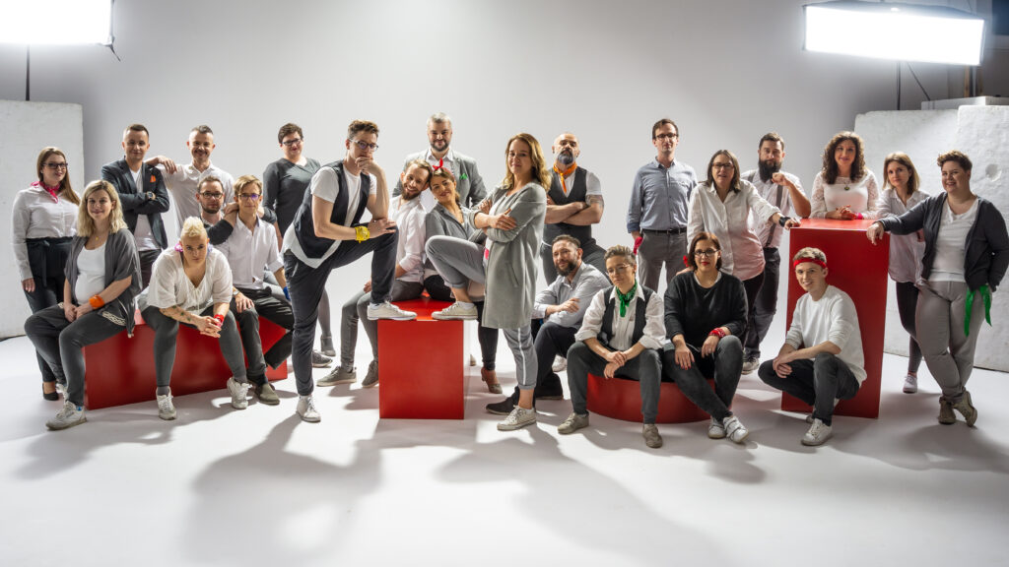
LEGATO Leadership College Brussels 14 June 2024
Section 2: Creating Your own Audience Development Plan
Voces Gaudii

Slide 12
LEGATO Leadership College Brussels 14 June 2024
Ten Steps to creating your own Audience Development Plan
Strategy:
1. Know Your Self (Brand)
2. Know Your Audience
3. What Are You Offering?
4. Set Your Goals
Activity:
5. Put Yourself Online
6. Get Your Choir Noticed (Marketing & Comms Activity)
7. Connect with Your Communities
8. Living Your Story and Your Values
Learning:
9. Learning, Listening and Reflecting
10. Create Your Five-Year Plan

Slide 13
LEGATO Leadership College Brussels 14 June 2024
1. Know Your Self (Your Brand)
Brighton Gay Men’s Chorus

Slide 14
LEGATO Leadership College Brussels 14 June 2024
1. Know Your Self (Your Brand)
Brand is more than logo, name and tone of voice. It’s your identity, values, how you present yourself to the world, and how the world feels about you.
What are your Mission, Vision and Values?
What do you offer and what makes you stand out?
How do you want people to feel about your choir? (members, performance audiences, the wider LGBTQ+ community)

Slide 15
LEGATO Leadership College Brussels 14 June 2024
Key Questions when reviewing Mission, Vision & Values
Who do you want your members to be in five years’ time?
Who do you want your audiences to be five years’ time?
What experience do you want out members and audiences to have?
What do you want people to say about you in five years’ time?
What do you want to be performing in five years’ time?
Where do you want to be performing in five years’ time?
Who does similar things and what are they offering? How are you different?
Are your mission, vision and values realistic? Do you have evidence of potential?

Slide 16
LEGATO Leadership College Brussels 14 June 2024
Other things to consider:
Does your name reflect your Mission, Vision and Values?
Does your logo and visual brand reflect your Mission, Vision and Values?
Does your tone of voice reflect your Mission, Vision and Values?
Does your online presence reflect your Mission, Vision and Values?

Slide 17
LEGATO Leadership College Brussels 14 June 2024
Activity time!
Introduce yourselves and, as clearly as possible, tell each other:
What is your choir’s mission?
What is your choir’s vision?
What are your choir’s values?
What makes your choir different from other LGBTQ+ choirs?

Slide 18
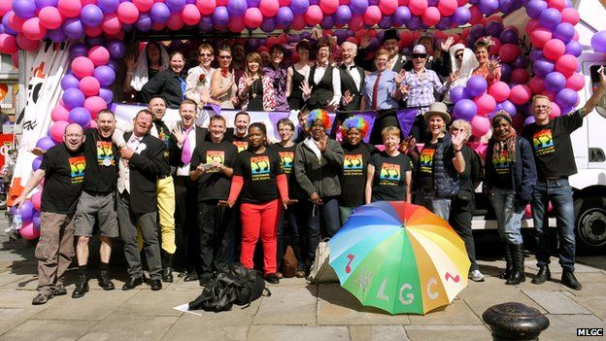
LEGATO Leadership College Brussels 14 June 2024
2. Know Your Audiences
Manchester Proud Chorus

Slide 19
LEGATO Leadership College Brussels 14 June 2024
2.1 Your Current Audiences
What do you know about your current members and audiences?
Demographics Sexuality Gender identity Age Location Disability Ethnicity or cultural identity | Behaviour: How often do they attend? What do they think about your choir? What difference do you make to their lives? What do they want from your choir? Would they bring a friend?

Slide 20
LEGATO Leadership College Brussels 14 June 2024
How to collect this data?
Member surveys
Attendance Registers
Box Office Information
Online audience surveys
Physical audience surveys
Open discussions with choir members
Ask social media followers for feedback
Anecdotal feedback

Slide 21
LEGATO Leadership College Brussels 14 June 2024
Segmenting your Audiences
By Frequency Very loyal, regular audiences who attend most performances Loyal audiences who attend once a year Infrequent audiences who occasionally attend First time audiences who have attended once Lapsed audiences who used to attend but have stopped | By Interests: LGBTQ+ Celebration Audiences: interested in Pride performances & LGBTQ+ celebration events Classical Audiences: interested in attending classical choir programmes Family & Friends: people directly invited by choir members Sondheim Superfans: will come to anything Sondheim. Crossover Audiences: interested in anything and come to everything

Slide 22
LEGATO Leadership College Brussels 14 June 2024
2.2 Targeting New Audiences & Members
What new audiences and members do you want to attract to your choir?
Important things to consider when deciding your priorities:
What are the demographics of your local LGBTQ+ and cultural communities?
Do your new audience priorities reflect your vision, mission and values?
Set five-year SMART Goals
Balance core audiences/members and new target audiences/members
Survey or interview potential audiences or members
Talk to people – and listen

Slide 23
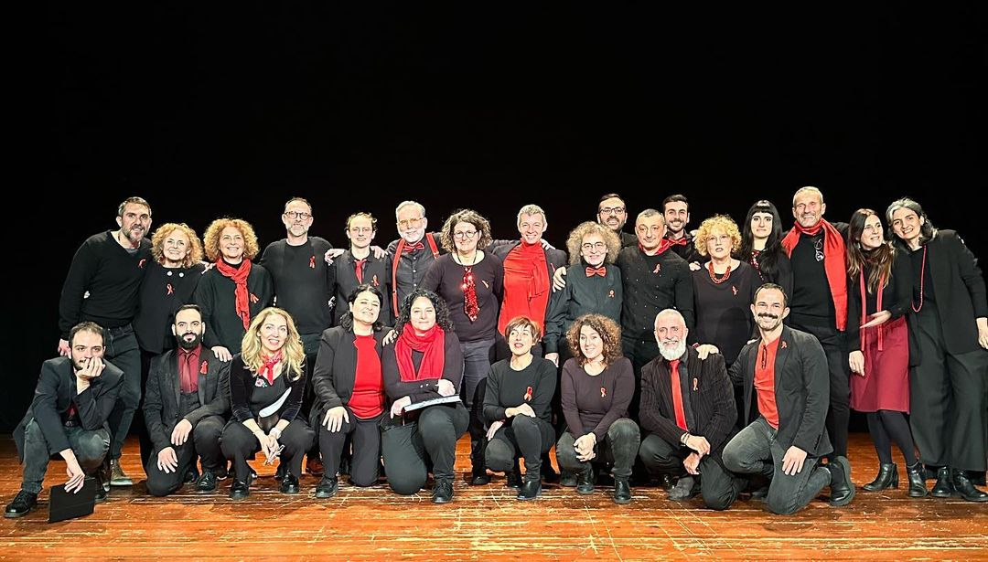
LEGATO Leadership College Brussels 14 June 2024
3. What are you offering?
Cromatica Choir

Slide 24
LEGATO Leadership College Brussels 14 June 2024
Your Programme
Review what it is you offer your members and audiences, and ask yourself if it reflects their needs and interests?
Programme Elements to consider could include:
Repertoire
Performances & Concerts
Collaborations & Commissions
Performance & Rehearsal Venues
Rehearsals
Workshops, Learning & Skills Activities
Community Outreach & Engagement

Slide 25
LEGATO Leadership College Brussels 14 June 2024
Your Musical Director
Find the right musical director for your Vision.
What is their role in your choir?
Do they understand and believe in your Mission, Vision and Values?
Do they listen and are they willing to try new things?
Are they excited by your choir’s purpose?
Are they right for your choir?

Slide 26
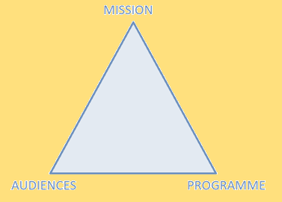
LEGATO Leadership College Brussels 14 June 2024
4. Set Your Goals

Slide 27
LEGATO Leadership College Brussels 14 June 2024
Revisit those Key Mission, Vision and Values Questions
Who do you want your members to be in five years’ time?
Who do you want your audiences to be five years’ time?
What experience do you want out members and audiences to have?
What do you want people to say about you in five years’ time?
What do you want to be performing in five years’ time?
Where do you want to be performing in five years’ time?
Who does similar things and what are they offering? How are you different?

Slide 28
LEGATO Leadership College Brussels 14 June 2024
Create SMART Goals
Specific
Measurable
Achievable
Relevant
Time-bound
Example:
Over the next 12 months my choir will retain 50% of new members

Slide 29
LEGATO Leadership College Brussels 14 June 2024
Activity time!
Using your own choir or invent your own choir, decide:
What your choir’s Mission is
Who your choir’s existing audience is
One priority new audience for your choir
Then come up with three SMART audience/member goals for your choir.
Try and include one goal that’s about your programme.

Slide 30
LEGATO Leadership College Brussels 14 June 2024
Signs of a Good Plan
Shared ownership
You’ve Done Your Research
You’ve Listened
Understandable
Realistic
Balanced
Aspirational
And the biggest questions…
What will you need to change to reach new audiences?
Are you ready and willing to change?

Slide 31
LEGATO Leadership College Brussels 14 June 2024
ANSOFF Matrix
The ANSOFF Matrix is a really useful tool for planning what your choir is going to do to grow its core audience while attracting new target audiences.
 | Programme: Existing | Programme: New
Audiences: Existing | Maximise current audiences Same programme, same people. Aim: …. Strategies: … Low risk, low cost | Programme Development New programme, same people Aim: … Strategies: … Medium risk, medium cost
Audiences: New | Increase similar audiences Same programme, new people Aim: … Strategies: … Medium risk, medium cost | Diversify Offer New programme, new people. Aim: … Strategies: … High risk, high cost

Slide 32
LEGATO Leadership College Brussels 14 June 2024
 | Programme: Existing | Programme: New
Audiences: Existing | Maximise current audiences Same programme, same people. Aim: Increase frequency of attendance from current audience and bring back lapsed ones. Strategies: Annual regular events, newsletter, early access for supporters, email people who attended previous concerts… Low risk, low cost | Programme Development New programme, same people Aim: Encourage audiences to try new things and extend range of our programme Strategies: Cross-promotion with existing events, comms campaign explaining new project, respond to feedback, take small steps with programming in Year 1 and then expand in Y2 Medium risk, medium cost
Audiences: New | Increase similar audiences Same programme, new people Aim: attract new audiences for the first time Strategies: Refer a friend discounts, preview pop-up performances, share recordings of previous performances on social media, additional information, early bird booking incentives for first time audiences , more ways for people to get involved in events Medium risk, medium cost | Diversify Offer New programme, new people. Aim: New programme to attract completely new audiences Strategies: Research and consultation, partnerships with relevant groups, collaboration, working with community ambassadors, plans for follow-on project, free or low cost targeted ticket offers High risk, high cost

Slide 33
LEGATO Leadership College Brussels 14 June 2024
TIME FOR A 10 MINUTE BREAK!

Slide 34
LEGATO Leadership College Brussels 14 June 2024
5. Put Yourself Online
Clear and easy to use website Top Website tip #1: Ask different people what information they need to find on your website Top Website tip #2: Ask people to find specific information on your website and ask how easy it was
The right Social Media platforms for you
Your Social Media content
Choir recordings & materials
Newsletters and mailing lists
Analytics & Search Engine Optimisation.
And remember…
Keep your website and social media up to date!

Slide 35
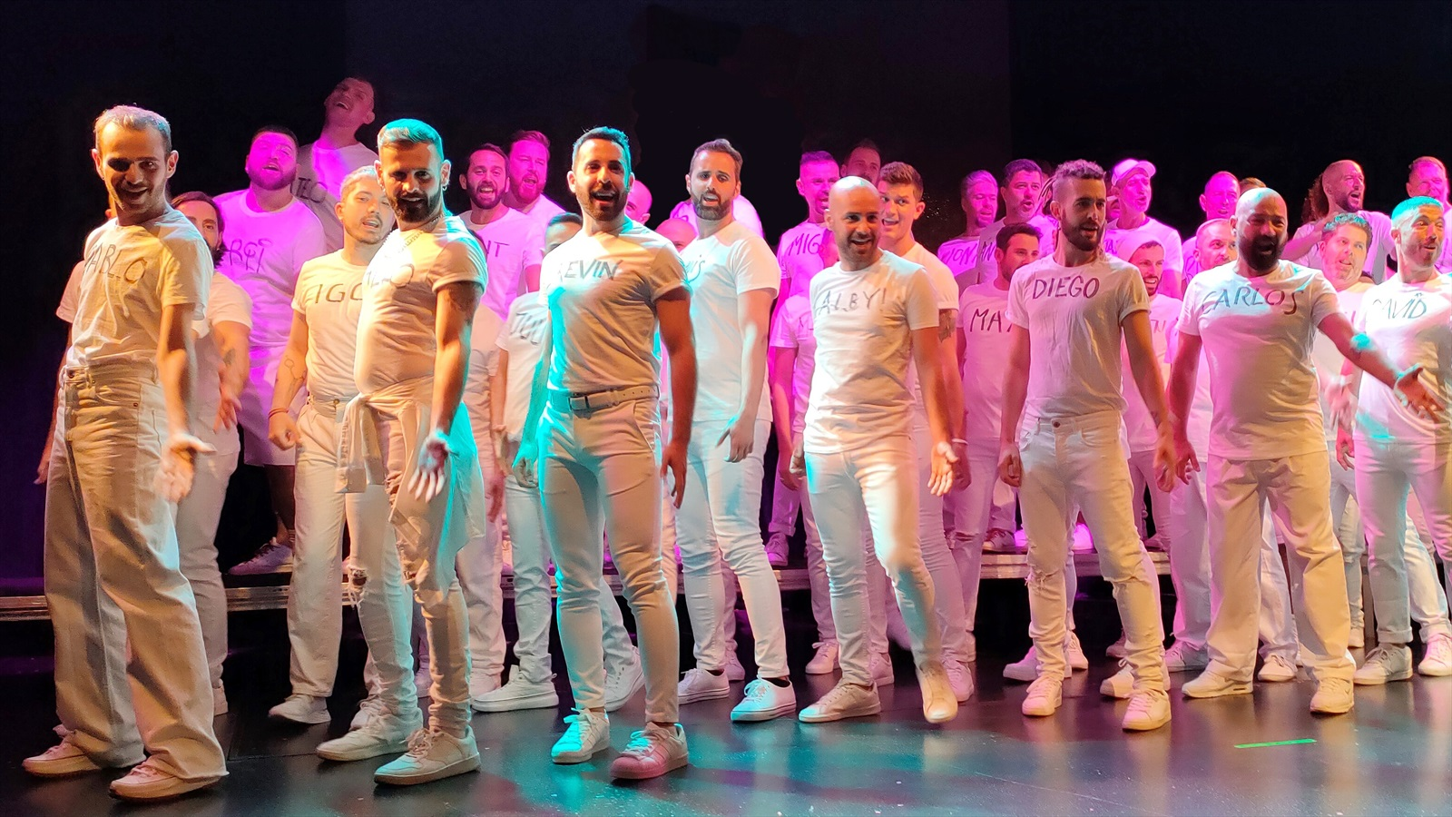
LEGATO Leadership College Brussels 14 June 2024
6. Get Your Choir Noticed (Marketing & Comms)
Barcelona Gay Men’s Chorus

Slide 36
LEGATO Leadership College Brussels 14 June 2024
6. Get Your Choir Noticed (Marketing & Comms)
Examples of Marketing & Comms Activities:
Online Advertising (i.e. Facebook and Instagram)
Online Listings & What’s On Guides
Flyers & Posters
Press Releases to local Media
Ticket & Membership Discount Schemes
Social Media content
Pop-Up Performances
Sharing

Slide 37
LEGATO Leadership College Brussels 14 June 2024
Marketing / Audience Matrix
 |  | TARGET AUDIENCE
MARKETING ACTIVITY |  | Folk Music Audiences | Choir Friends & Family | LGBTQ+ Community Groups
 | Teaser Trailer Facebook Campaign | X | X | X
 | Newsletter |  | X
 | Short Video Interviews with Guest Artist | X | X | X
 | Ticket Offer for LGBTQ+ support groups |  |  | X
 | Poster Campaign | X |  | X
 | Referral Discount |  | X

Slide 38
LEGATO Leadership College Brussels 14 June 2024
Things to remember…
As well as audiences, also consider resources: Time, Budget, People and SkillsPeople & Skills
Useful things to remember when planning your marketing…
Show AND Tell
Different messages work for different audiences
Be honest
Plan your Time (12-8 weeks): Give time for the different stages of marketing: 1 - Awareness & Announcement 2 - Information 3 -Desire 4 - Action (buying tickets / signing up)
Be Versatile and adapt

Slide 39
LEGATO Leadership College Brussels 14 June 2024
Learn from what works… and what doesn’t!
Have contingency plans and budgets in case things go wrong
Regularly review and respond: If something is working really well, why not invest more. If something really isn’t working, try something else.
Marketing Return On Investment:
ROI = Income Generated – Cost of Marketing
Cost of Marketing
Cost Per Head = Number of Audiences
Cost of Marketing

Slide 40
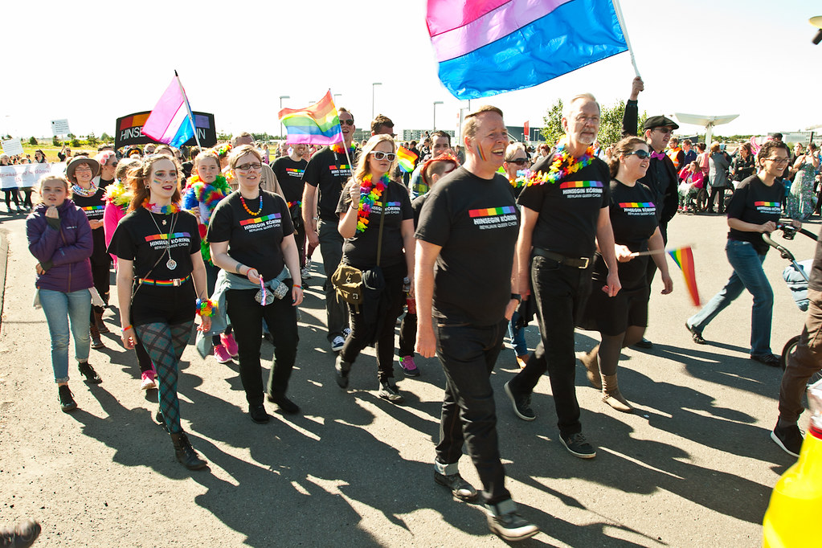
LEGATO Leadership College Brussels 14 June 2024
7. Connect with Your Communities
Hinsegin Kórinn - Reykjavík Queer Choir

Slide 41
LEGATO Leadership College Brussels 14 June 2024
7. Connect with Your Communities
LGBTQ+ Advocacy and Activism
Pride Events
Arts Venues and Festivals
Collaboration
Partnerships
Workshops & Events
Paid Opportunities

Slide 42
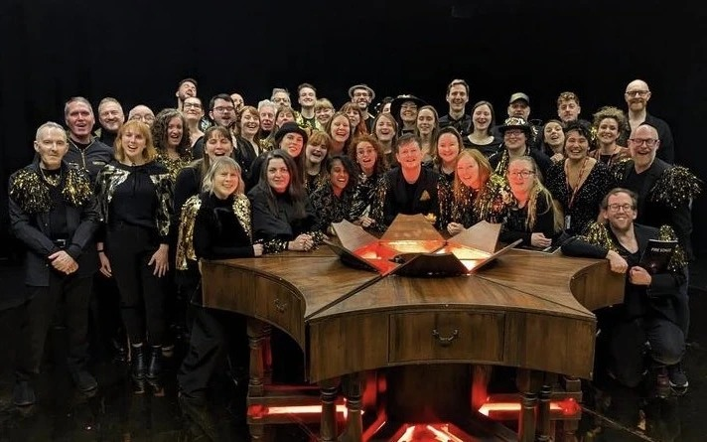
LEGATO Leadership College Brussels 14 June 2024
8. Live Your Stories and Your Values
The Sunday Boys and SHE Choir with Frozen Light Theatre Company for people with Profound Multiple Learning Difficulties

Slide 43
LEGATO Leadership College Brussels 14 June 2024
8. Live Your Stories and Your Values
Your Key Messages
New Members’ Joining Experience
Accessibility
Representation
Bring Your Choir on Your Journey
Are you ready and willing to change?

Slide 44
LEGATO Leadership College Brussels 14 June 2024
9. Learning, Listening and Reflecting
Annual Surveys and Benchmarking
Data Analysis
Project Evaluation – choir members
Project Evaluation – audiences
Project Evaluation – debrief
Review Your SMART goals (stage 4)

Slide 45
LEGATO Leadership College Brussels 14 June 2024
Learning Cycle

Slide 46
LEGATO Leadership College Brussels 14 June 2024
10. Create Your Five Year Plan (an example)
Year 1: Building Foundations Understand Your Brand Understand your Audiences and Communities Set Your Goals Build Partnerships Build Your Annual Programme Build Your Online Presence Listen, Learn and Evaluate | Year 2: Reinforce and Experiment Re-emphasise Your Brand Review and Set New Goals Strengthen partnerships Test New Ideas Listen, Learn and Evaluate

Slide 47
LEGATO Leadership College Brussels 14 June 2024
10. Create Your Five Year Plan (an example)
Year 3: Expand and Diversify Expand and Diversify Programme & Repertoire Reach New Audiences Collaboration Listen, Learn and Evaluate | Year 4: Reinforce and Establish Deepen engagement with new audiences Commit but Adapt Listen, Learn and Evaluate | Year 5: Evaluate, Celebrate and Plan Ambition & Celebration Listen, Learn and Evaluate Plan for Long-Term Sustainability Celebrate Achievements and share stories Revisit mission, vision and values

Slide 48
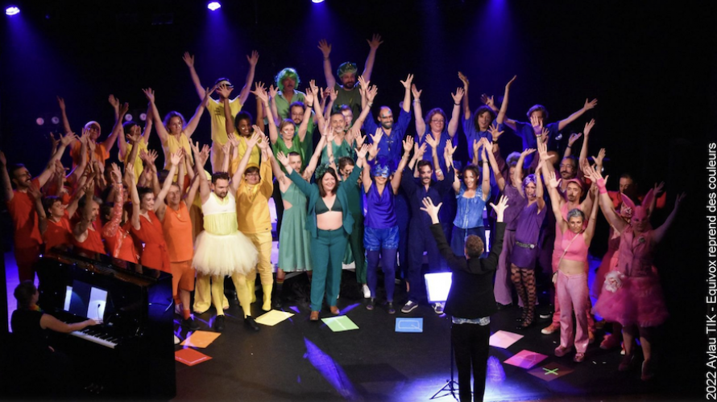
LEGATO Leadership College Brussels 14 June 2024
We’ve reached the end of the presentation!
Equivox – Le choeur LGBTQIA+ de Paris

Slide 49
LEGATO Leadership College Brussels 14 June 2024
We’ve reached the end of the presentation!
Three key things to remember:
It takes time, perseverance and learning.
Stick to your goals, but adapt and learn and listen.
You can’t do it alone – bring your choir on the journey with you.

Slide 50
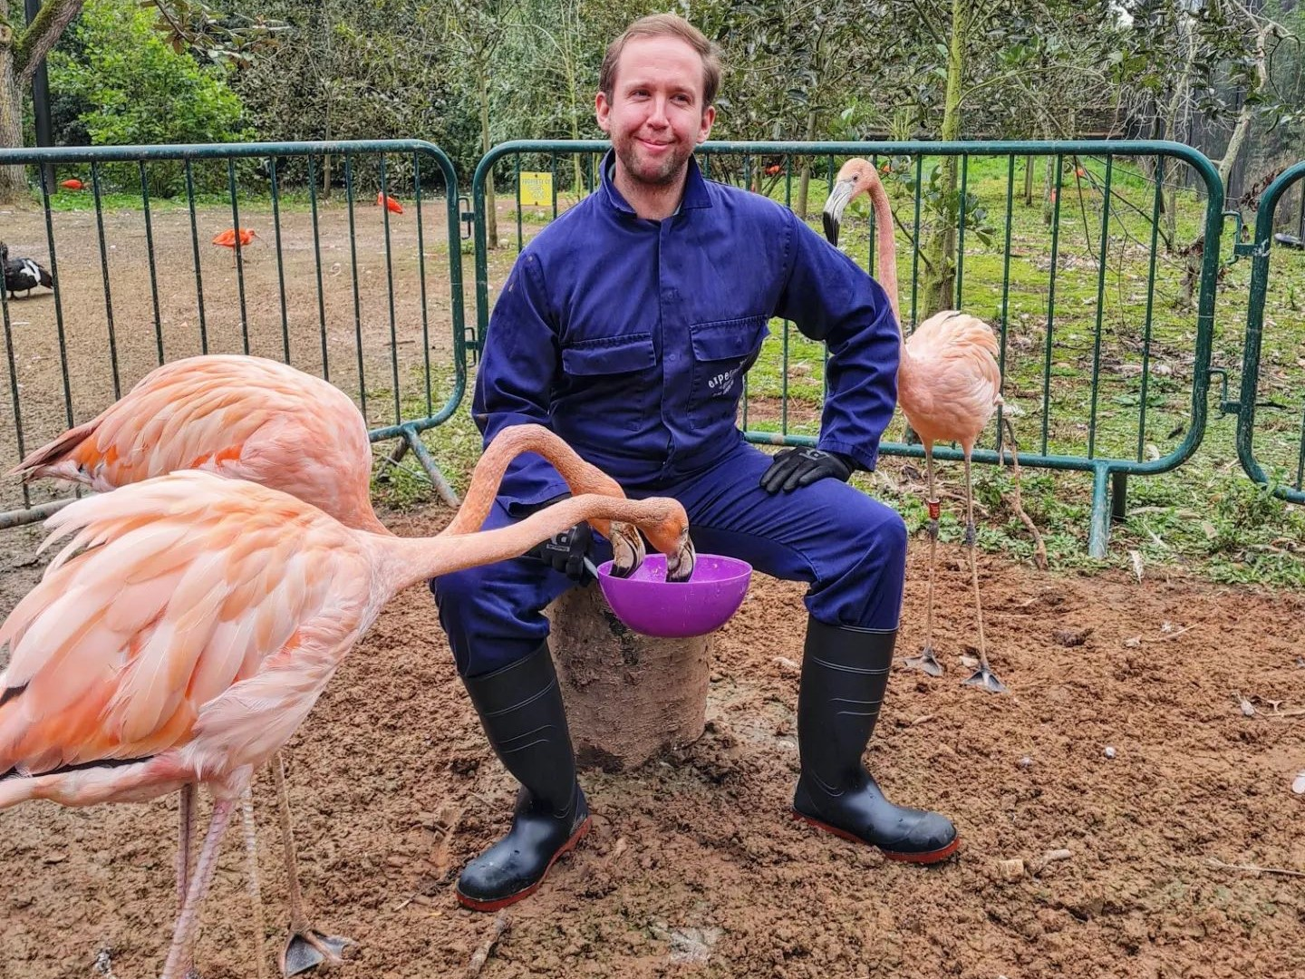
LEGATO Leadership College Brussels 14 June 2024
Thank You!

Slide 51
LEGATO Leadership College Brussels 14 June 2024
Group Discussion & Advice Surgery

